Slide 1
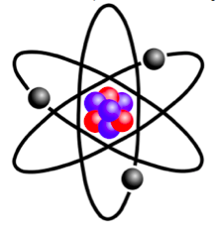
Lecture 12: Many electron Atoms –Spin and Slater Determinants

Slide 2
Recapitulation: Many Electron Atoms
, 1-electron Hamiltonians
Inter-electron repulsion terms:
CANNOT be ignored
Hamiltonian is no longer spherically symmetric and the Time-Independent Schrodinger Equation (TISE) cannot be solved using analytical techniques
Numerical methods must be used solve the TISE

Slide 3
Recapitulation: Effective Nuclear Charge
For Helium atom

Slide 4
Recapitulation: Effective Nuclear Charge
Due to Shielding, the electrons do not see the full nuclear charge Z, but Z_{eff} = Z–σ (σ = Shielding Constant)
For Helium atom
There are methods such as Perturbation Theory and Variational Method to estimate Z_{eff}

Slide 5
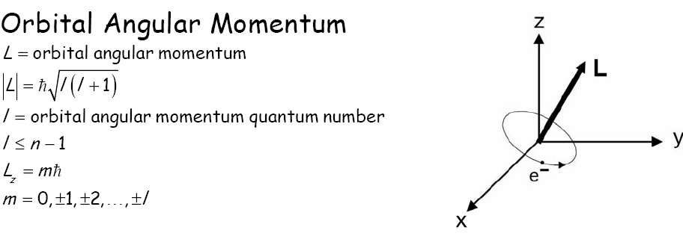
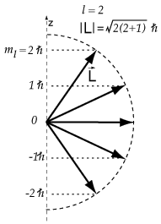
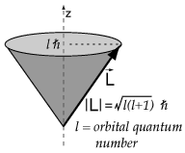
Spatial (Orbital) Angular Momentum of Electrons in the atom
Notes:
5

Slide 6
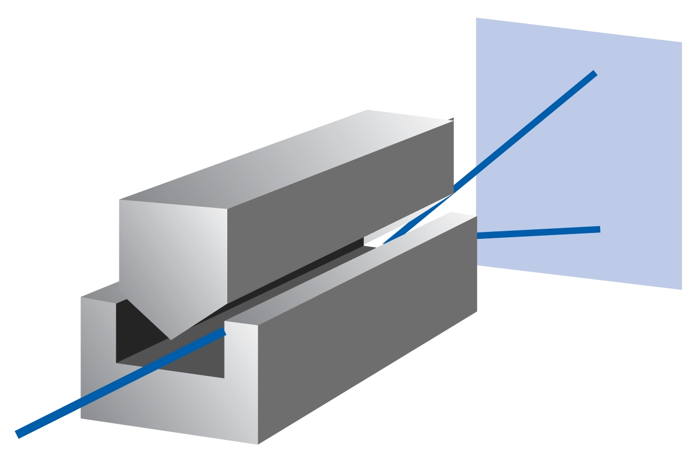
“Spin” of an electron: Later comer to the quantum party
Stern-Gerlach Experiment (1922):
Beam of Ag atoms (4d¹⁰ 5s¹) passed through an inhomogeneous magnetic field: TWO lines
Uhlenbeck and Goudsmit (1925): Two angular momentum states, Intrinsic to the electron
NOT a result of actual rotation (v >c !!)
Spin: S(ω), ω is an unknown coordinate
Dirac: Relativistic quantum mechanics

Slide 7
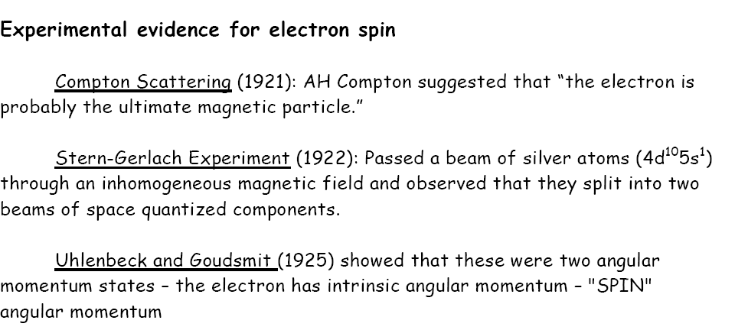
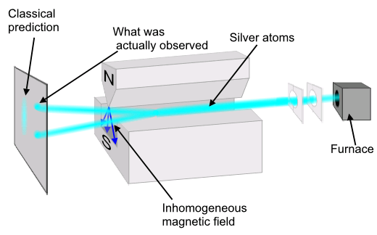
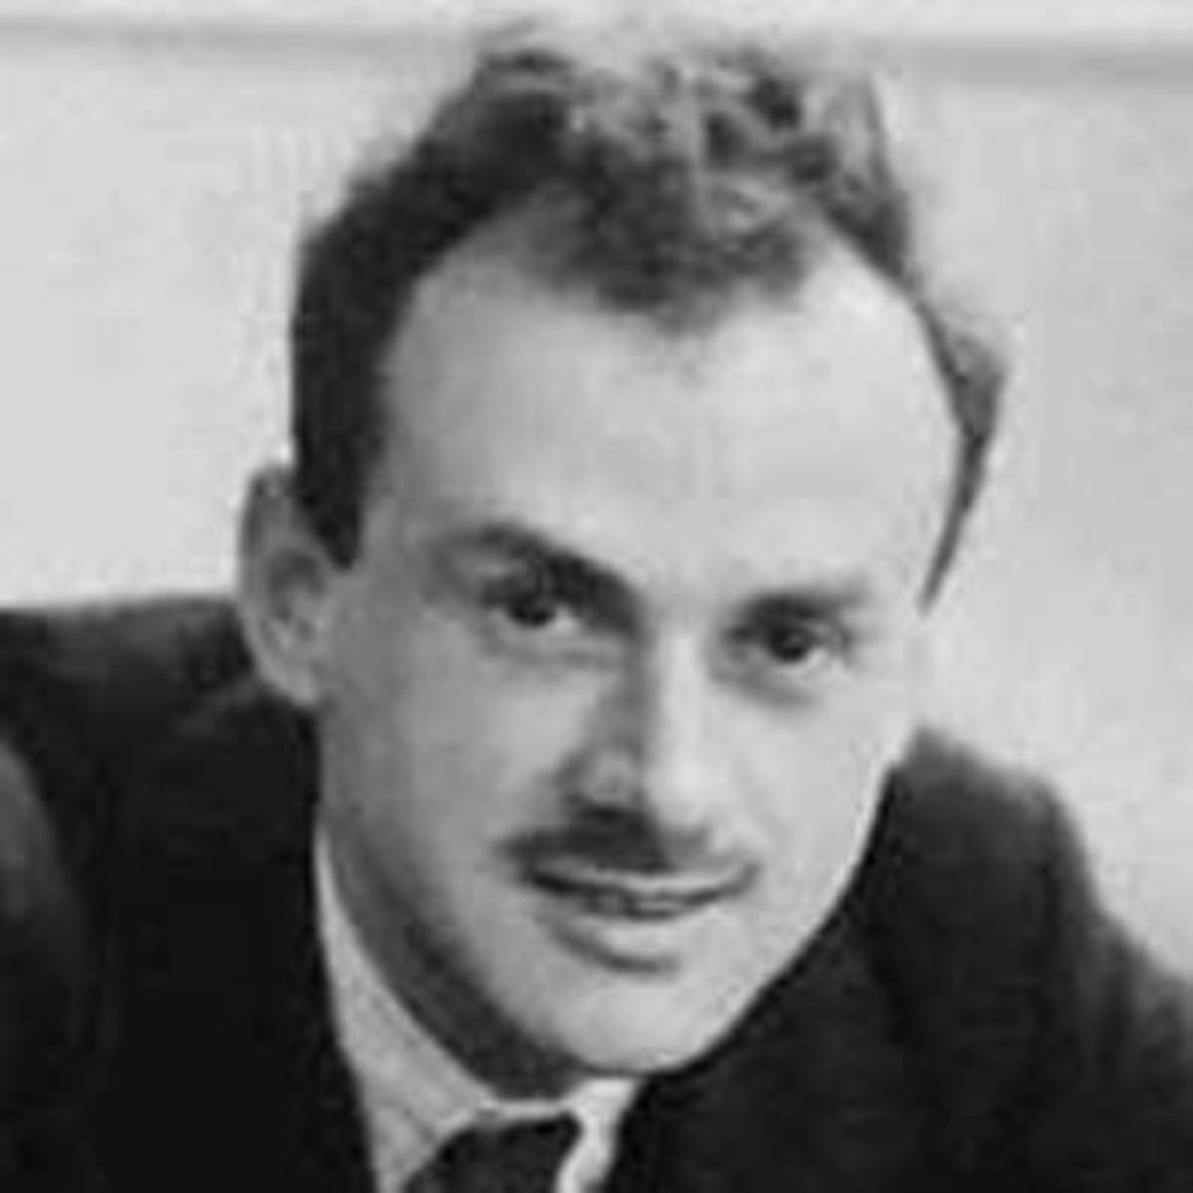
Intrinsic Angular Momentum: “Spin”
Na/Ag atoms: ns1: l=0:
Zero Orbital Momentum
For 1S electrons
If electrons are classical, "spinning" particles, then distribution of their spin
angular momentum vectors is taken to be truly random and each particle would
be deflected up or down by a different amount, producing an even distribution.
But electrons deflected either up or down by a specific (same) amount!!!

Slide 8
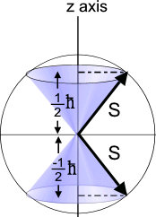
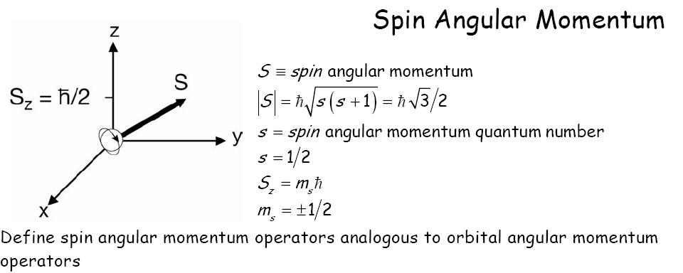
Spin Angular Momentum : Intrinsic and Quantized
Spin Angular Momentum “S’’
For electrons, s = 1⁄2
“spin-up” (or α) and “spin-down” (or β) two eigenfunctions (spin functions) of the operator, same eigen values but opp sign (S-G observables)
NOT a result of actual rotation (v >c !!)

Slide 9
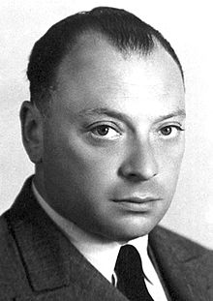
Spin
Completely quantum mechanical property
No classical analogy
Intrinsic (like charge or mass)
Pauli (1924) : “ electron has two-valuedness not describable classically ”

Slide 10
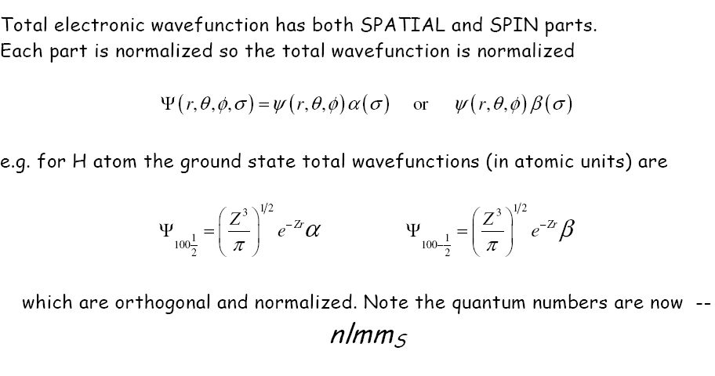
Hydrogen Atom Wavefunctions: Redefined
Incorporate “spin” component to each of the 1-electron wavefunctions: SPIN ORBITALS
Total wavefunctions = product of spatial and spin parts
Each atomic orbital now becomes doubly degenerate
Spin orbitals are orthogonal and normalized. Quantum numbers are n,l,m,m_{s}
SPIN ORBITAL: One electron wavefunction containing spatial as well as spin parts

Slide 11
Hydrogen Atom Wavefunctions: Redefined
SPIN ORBITAL: One electron wavefunction containing spatial as well as spin parts

Slide 12
Spin Orbitals and their linear combinations
Two electron system (electron labels: 1 and 2): four spin functions
✔
✔
+
Linear combination
1 and 2: indistinguishable
Wavefunctions must reflect indistinguishability of electrons:
No known experiments can differentiate between two electrons;
No observables change if co-ords of 2 electrons are interchanged.
Exchange Operator
Symmetric
Anti-symmetric
Notes:
Not the natural Quantum state of electrons, what they find themselves in is the quantum superposition of up, down or down up meaning linear combination! No intutive calssical picture
They are entangled! i.e they have no direction of their own but are of opp directtion to each other!

Slide 13
6th Postulate of Quantum Mechanics
The complete wavefunction of a system of identical fermions (e.g. electrons) must be anti-symmetric with respect to interchange of all their coordinates (spatial and spin) of any two particles
Pauli’s Principle: Derived using relativistic QM
independently derived by Dirac and Heisenberg/Pauli

Slide 14
He-atom Wavefunctions for 1S²
For He atom ground state (both electron in 1s): 1s(1).1s(2)
Space part:
SYMMETRIC:
How to choose spin part? MUST be ANTI-SYMMETRIC function
even*odd=odd; odd*even=odd; even*even=even; odd*odd=even
2e spin
functions are:
Total wavefunction of
He (GS) :anti-symmetric
wrt exchange of the two electronic coordinates
Notes:
14

Slide 15
6th Postulate of Quantum Mechanics
The complete wavefunction of a system of identical fermions (e.g. electrons) must be anti-symmetric with respect to interchange of all their coordinates (spatial and spin) of any two particles
He atom wavefunction:
What if the two electrons in 1s orbital had same spin?
NOT ALLOWED
Pauli exclusion principle

Slide 16
He Atom Wavefunction: Writing anti-sym. wavefunctions
Slater
determinant
Exchange of two rows/ columns: Change in sign
Antisymmetric
If any two rows/columns are same, then the determinant becomes zero.
no two electrons occupy the same spin orbital.
Pauli Exclusion Principle
Notes:
The wavefunction is o if all the quantum wavenumbers of any two electrons are the same!!

Slide 17
Many Electron Atoms: Determinantal Wavefunctions
Slater
determinant
1s(3)α(3)
If any two rows/columns are same, then the determinant becomes zero.
no two electrons occupy the same spin orbital.
Pauli Exclusion Principle

Slide 18
Slater Determinant for Li (3e): 1s²2s¹
Spin orbitals change across columns
Electrons
What if we put the 3rd e of Li in 1s (spatial) orbital?
When two columns/rows of determinant are equal,
Then value of the determinant is….
➔No more than two electrons occupy a spatial orbital

Slide 19
Helium Atom: Excited States
If the second electron is in the 2s orbital then it could have the same spin or the opposite spin.
He excited state 1s¹.2s¹
He excited state 1s¹.2s¹

Slide 20
Helium Atom: Excited States
If the second electron is in the 2s orbital then it could have the same spin or the opposite spin.
He excited state 1s¹.2s¹
He excited state 1s¹.2s¹

Slide 21
Helium Atom: Excited States
If the second electron is in the 2s orbital then it could have the same spin or the opposite spin.
He excited state 1s¹.2s¹
He excited state 1s¹.2s¹

Slide 22
Helium Atom: Excited States
If the second electron is in the 2s orbital then it could have the same spin or the opposite spin.
He excited state 1s¹.2s¹ (singlet)
He excited state 1s¹.2s¹ (triplet)

Slide 23
Helium Atom: Excited States
He excited state 1s¹.2s¹ (triplet)
1s(1)α(1) 2s(1)α(1)
3,1
Ψ = 1/√2
1s(2)α(2) 2s(2)α(2)

Slide 24
Helium Atom: Excited States
He excited state 1s¹.2s¹ (triplet)
1s(1)α(1) 2s(1)α(1)
3,1
3,-1
Ψ = 1/√2
Ψ =
1s(2)α(2) 2s(2)α(2)

Slide 25
Helium Atom: Excited States
He excited state 1s¹.2s¹ (triplet)
1s(1)α(1) 2s(1)α(1)
1s(1)β(1) 2s(1)β(1)
3,1
3,-1
Ψ = 1/√2
Ψ = 1/√2
1s(2)α(2) 2s(2)α(2)
1s(2)β(2) 2s(2)β(2)

Slide 26
Helium Atom: Excited States
He excited state 1s¹.2s¹ (triplet)
1s(1)α(1) 2s(1)α(1)
1s(1)β(1) 2s(1)β(1)
3,1
3,-1
Ψ = 1/√2
Ψ = 1/√2
1s(2)α(2) 2s(2)α(2)
1s(2)β(2) 2s(2)β(2)

Slide 27
Helium Atom: Excited States
He excited state 1s¹.2s¹ (triplet)
1s(1)α(1) 2s(1)α(1)
1s(1)β(1) 2s(1)β(1)
3,1
3,-1
Ψ = ¹/₂
Ψ = ¹/₂
1s(2)α(2) 2s(2)α(2)
1s(2)β(2) 2s(2)β(2)
3,0
1s(1)α(1) 2s(1)β(1)
1s(1)β(1) 2s(1)α(1)
Ψ = ¹/₂ + ¹/₂
1s(2)α(2) 2s(2)β(2)
1s(2)β(2) 2s(2)α(2)

Slide 28
Helium Atom: Excited States
He excited state 1s¹.2s¹ (singlet)

Slide 29
Helium Atom: Excited States
He excited state 1s¹.2s¹ (singlet)
1,0
1s(1)α(1) 2s(1)β(1)
1s(1)β(1) 2s(1)α(1)
Ψ = ¹/ ₂ - ¹/ ₂
1s(2)α(2) 2s(2)β(2)
1s(2)β(2) 2s(2)α(2)

Slide 30
Helium Atom: Excited States
Spin-orbital wavefunctions
are represented as
Slater determinants
or their sums

Slide 31
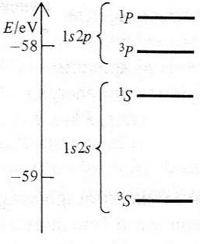
Helium Atom: Excited States
1s (1)1s (2) The spatial part is symmetric
1s (1)2s (2) or 1s (2)2s (1) symmetric or anti-symmetric
1s (1)2s (2) + 1s (2)2s (1) Symmetric
1s (1)2s (2) - 1s (2)2s (1) Anti-symmetric

Slide 32
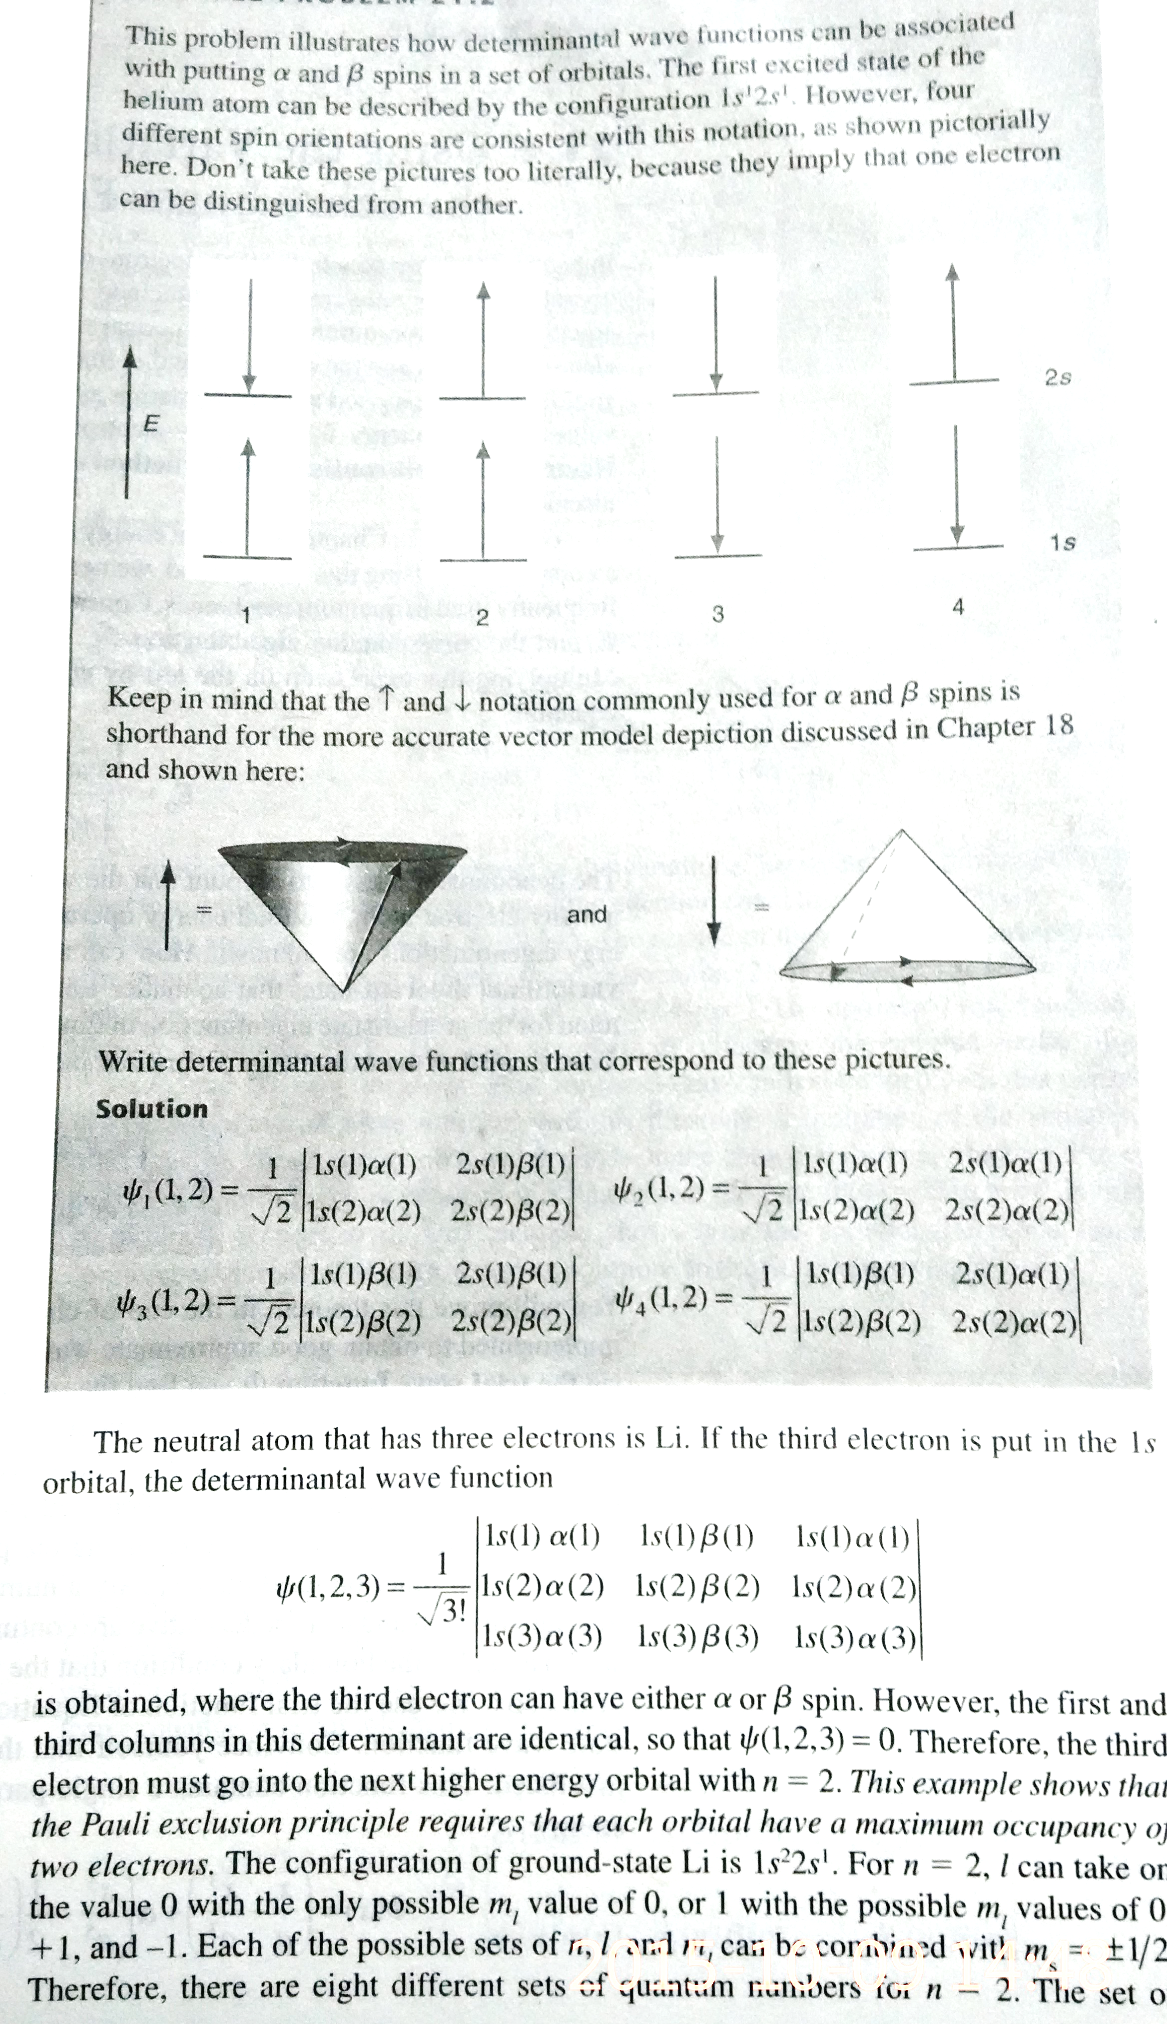
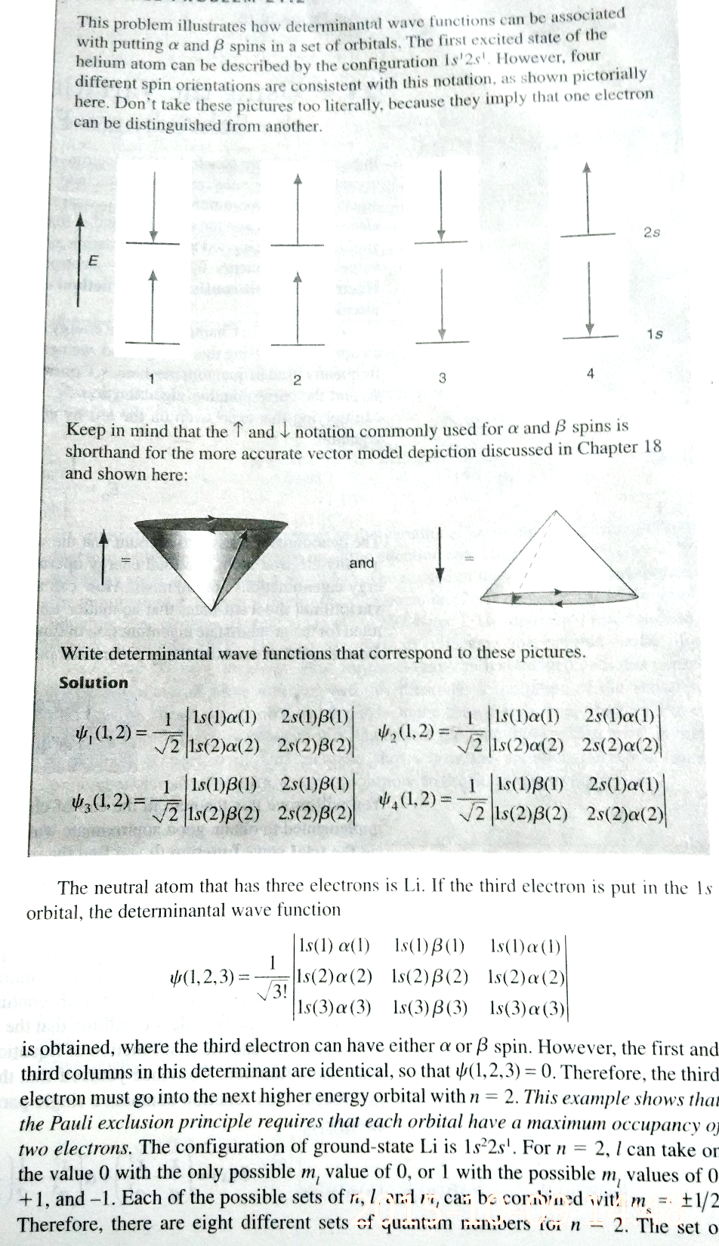
Slater determinants are not just any determinant: There is logic to it…

